Slide 1
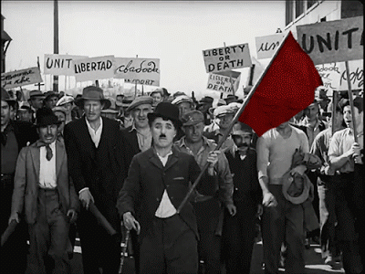
LEARNING OF
XVII CONGRESS - WFTU
APRENDIENDO DEL
XVII CONGRESO - FSM
TO SEE IN THE SHAPE
OF PRESENTATION
Ver en forma de presentación

Slide 2
LUCHA DE CLASES
SOLIDARIDAD
COMBATIVE UNITY
Federación Sindical Mundial
EMANCIPATION
ORGANIZATION
ADVANCE
CLASS FIGHT
AVANCE
SOLIDARITY
IDEOLOGÍA
REVOLUCIONARIA
World Federation Trade Union
CONGRESS
EDUCATION
IDEOLOGY
ACTION
AUTOCRITIC

